Slide 1
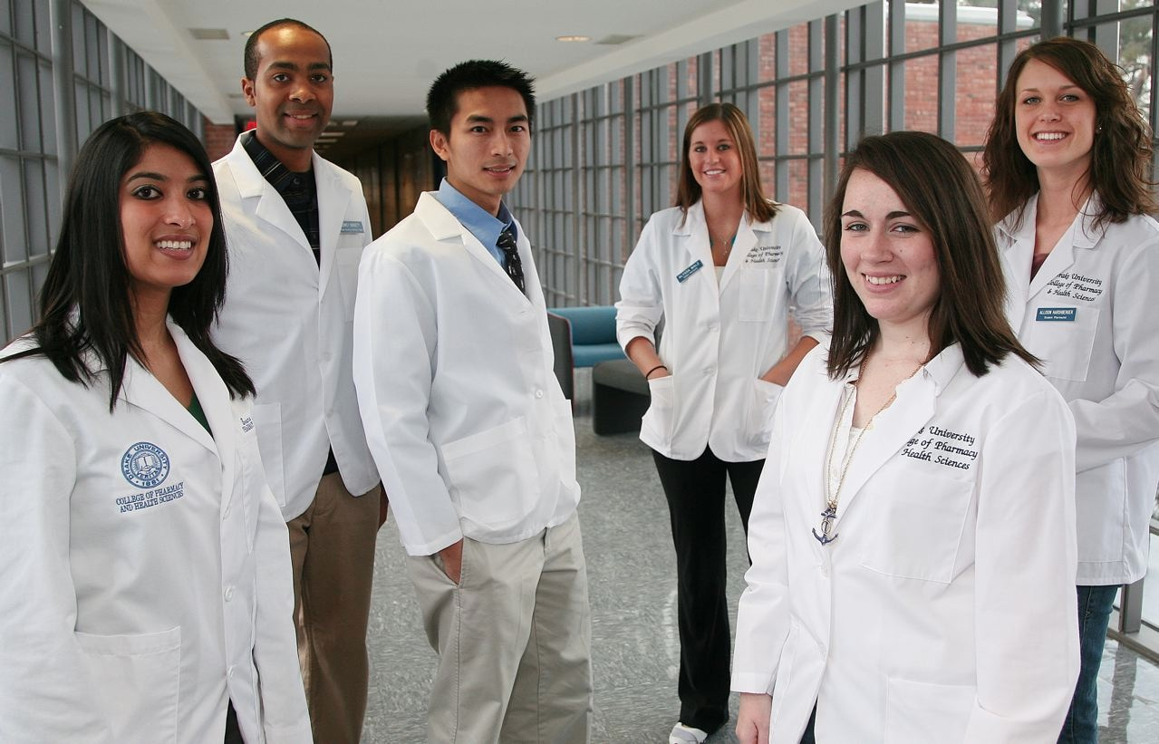
World of Choices:
Pharmacist

Slide 2
What do Pharmacists Do?
Talk to patients about their medications
Help patients to be safe
Compound medicines
Teach

Slide 3
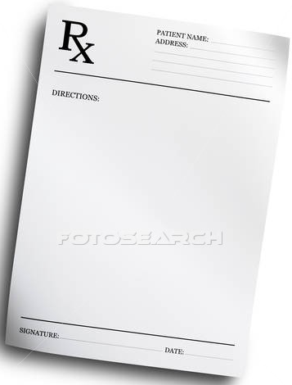
How many tablets does the pharmacist give the patient?
Take 2 tablets 3 times per day for 6 days

Slide 4
True or False?
It is ok to give someone else your medicine that comes from the pharmacy.
True
False
Medicines that come from a pharmacy are always safe and can be taken by anyone.
True
False

Slide 5
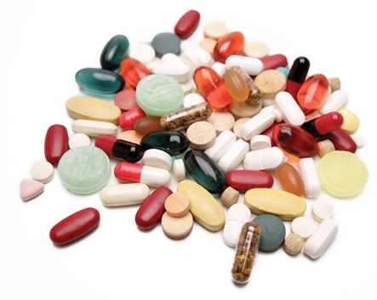
What do you think?
Why do teens abuse prescription drugs?
To get high
To relieve pain
To improve grades
To “fit in”
All of the above
Notes:
Why do you think teens abuse prescription drugs?
Answer: All of the above.
Do any of these reasons surprise you? Some students may not think “to improve grades” is a reason. You can bring up that this reason is growing widely and becoming a huge problem on college campuses. Many students are abusing stimulants so that they can stay focused for long periods of time and “cram” for an exam. Many students feel that those who abuse stimulants for academic purposes do have an advantage and this reason for abuse should be considered academic cheating.
Remember that unless you have a prescription, any of these reasons are considered abuse.
Lets look at some more statistics on why teens abuse prescription drugs…(transition to next slide).

Slide 6
What do you think?
Why do teens abuse prescription drugs?
To get high
To relieve pain
To improve grades
To “fit in”
All of the above
Notes:
Why do you think teens abuse prescription drugs?
Answer: All of the above.
Do any of these reasons surprise you? Some students may not think “to improve grades” is a reason. You can bring up that this reason is growing widely and becoming a huge problem on college campuses. Many students are abusing stimulants so that they can stay focused for long periods of time and “cram” for an exam. Many students feel that those who abuse stimulants for academic purposes do have an advantage and this reason for abuse should be considered academic cheating.
Remember that unless you have a prescription, any of these reasons are considered abuse.
Lets look at some more statistics on why teens abuse prescription drugs…(transition to next slide).

Slide 7
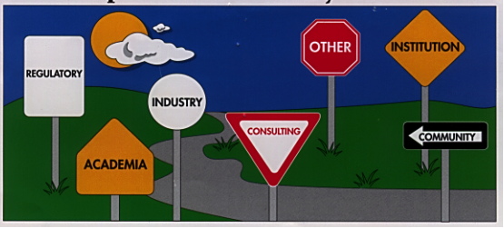
Many Careers

Slide 8
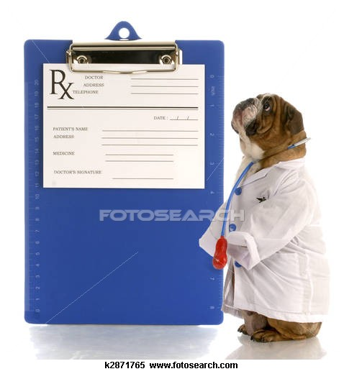
Education
PharmD (Doctor of Pharmacy)
>6 years (shortest path to become a Dean)
143 Pharmacy Colleges/Schools in the US
Iowa
Drake University
Univ. of Iowa

Slide 9
Type of Person
Good at math & science
Quick thinker
Nice
Patient
Hard worker

Slide 10
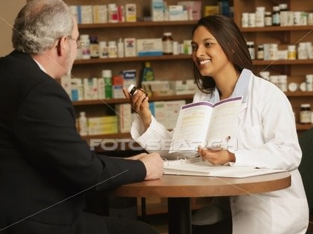
Things I like about Pharmacy
Helping Profession
Well-respected
Many career pathways
Salary

Slide 11
ADVICE
Take as many math and science courses as possible
Take as advanced of courses as possible.
Be involved in activities
Take the ACT and do well

Slide 12
Questions?

