Slide 1
A Genomics Education Project
Pramod B. Mahajan, PhD
Associate Professor of Pharmaceutical Science
Department of PA Sciences
College of Pharmacy and Health Sciences
Drake University, Des Moines, IA 50311

Slide 2
What it this?

Slide 3
It is not just another project..
It is a movement for STEM education ....

Slide 4
A home-grown genomics education technology

Slide 5
A STEM education opportunity for all Iowa students

Slide 6
Rationale

Slide 7
A Game Changer
Project
Rationale

Slide 8
Challenges for Healthcare Industry
Shortage of qualified workforce
Lack of trained educators
Diminishing student interest

Slide 9
It is not just another project..
It is a movement for STEM education ....

Slide 10
Project Components
CE Course for STEM Educators
Practicum for Students (6-12 grades)
A STEM education opportunity for all Iowa students.

Slide 11
Teaching Teachers Genomic Concepts And Applications
A Continuing Education Course
Approved by Heartland Education Agency for 3 CE credits
Duration : One week (45 hrs)
Didactic and Team based learning sessions
Hands-on Laboratory practicum
My laboratory or yours!

Slide 12
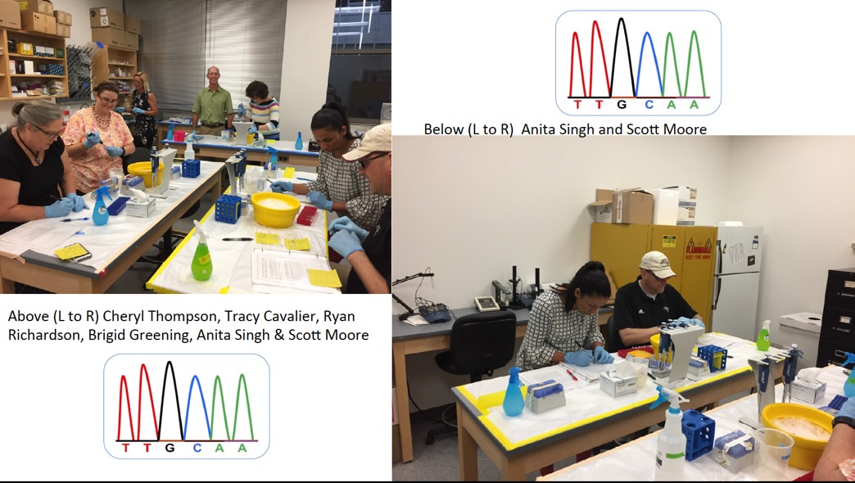
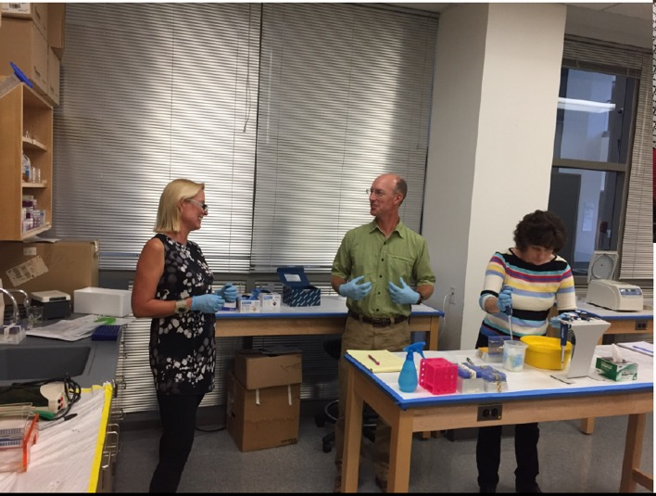
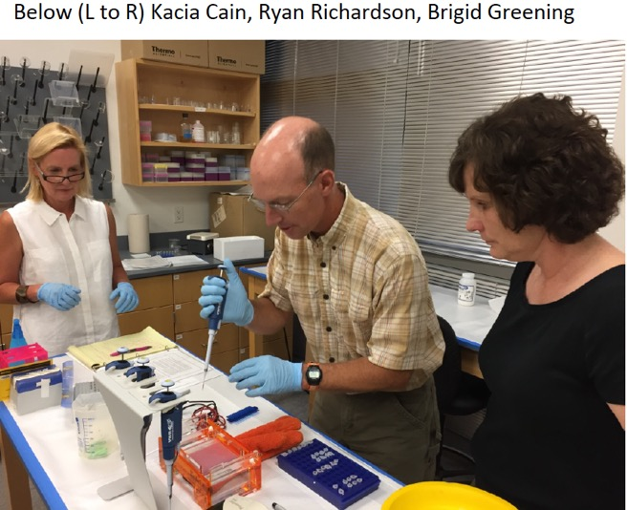
Below: Tracy Cavalier
Above:
Anita Singh and Ryan Richardson

Slide 13
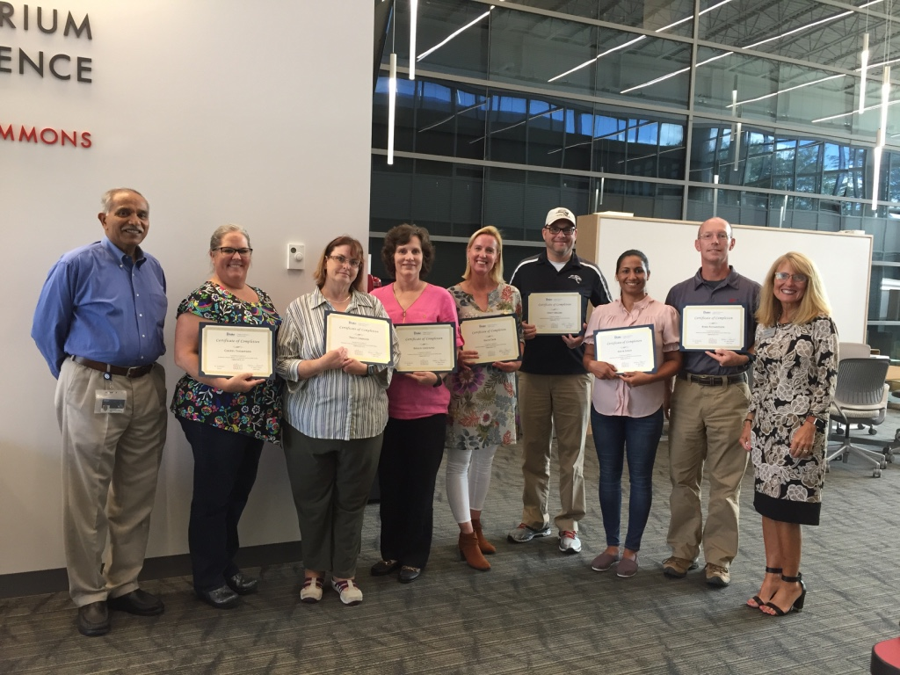
Teaching Teachers Genomic Concepts And Applications
Graduates of First TTGCAA® Course
L to R: P. Mahajan (Course Director) , C. Thompson, T. Cavalier, B. Greening, K. Cain, S. Moore, A. Singh, B. Richardson, C. Chesnut (Dean, CPHS)

Slide 14
Advantages of CE Course
First such CE course for STEM educators offered in Iowa
Enhanced knowledge of genomic concepts & applications
Hands-on experience in basic genomic methods
Professional development/networking
Opportunity to impact STEM education in Iowa

Slide 15
The Genomics Education Kit

Slide 16
Our Genomics Education Kit includes :
Consumable & reagents for isolation, amplification and analysis of human genomic DNA
An equipment package of four micropipettes, a microcentrifuge, a thermal cycler and an electrophoresis & imaging unit
A detailed Instruction Manual with links to educational materials
You bring enthusiastic students and a bunch of fresh cilantro!

Slide 17
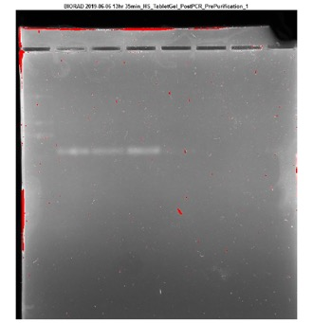
Our Genomics Education Kit is ....
Experiments carried out by Ms. Cain’s class at the Central Campus
Experiments carried out by Dr. Showalter’s class at Waukee High School
Teacher Approved and Student Tested!

Slide 18
Advantages of our Genomics Education Kit
Safe
Facile
Free from health/legal/ethical concerns
Several pedagogical advantages
Fun

Slide 19
For further information, contact:
Drake University
SC STEM HUB
Dr. Pramod B. Mahajan
Email: Pramod.Mahajan@Drake.edu
Phone: 515-271-3022
Dr. Sarah W. Derry
Email: Scstemhub@Drake.edu
Phone: 515-271-2403

